Slide 1
Dancing at two weddings: Tales from the front lines of LGBT-Religious dialogue
All rights belong to Benjamin A Katz. Enclosed materials should not be reproduced without permission.
Benjamin Katz
The Hebrew University of Jerusalem
Shoval: Education and Tolerance

Slide 2
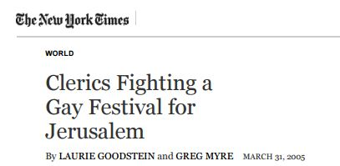
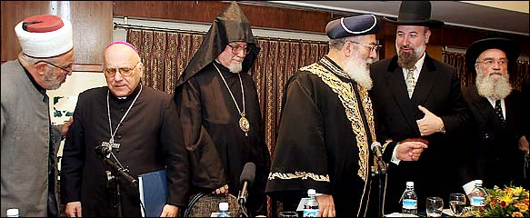
2005 Jerusalem pride
Left to right: Cleric Abdel Salem Menasra, Archbishop Aristarchos, Patriarch Michel Sabbah, Archbishop Aristarchos, Sephardic chief Rabbi Shlomo Amar, Ashkenazic chief Rabbi Yehuda Metzger
(not pictured: Sheik Abdel Aziz Bukhari)

Slide 3
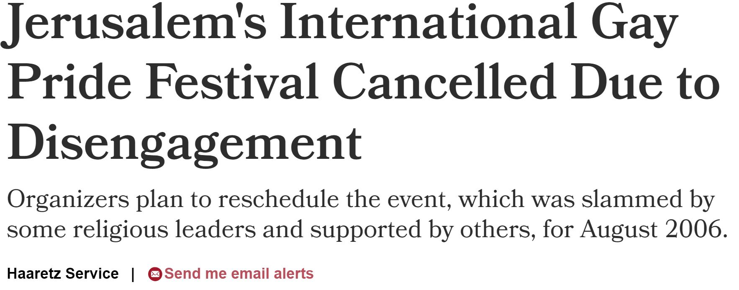
2006 Jerusalem pride

Slide 4

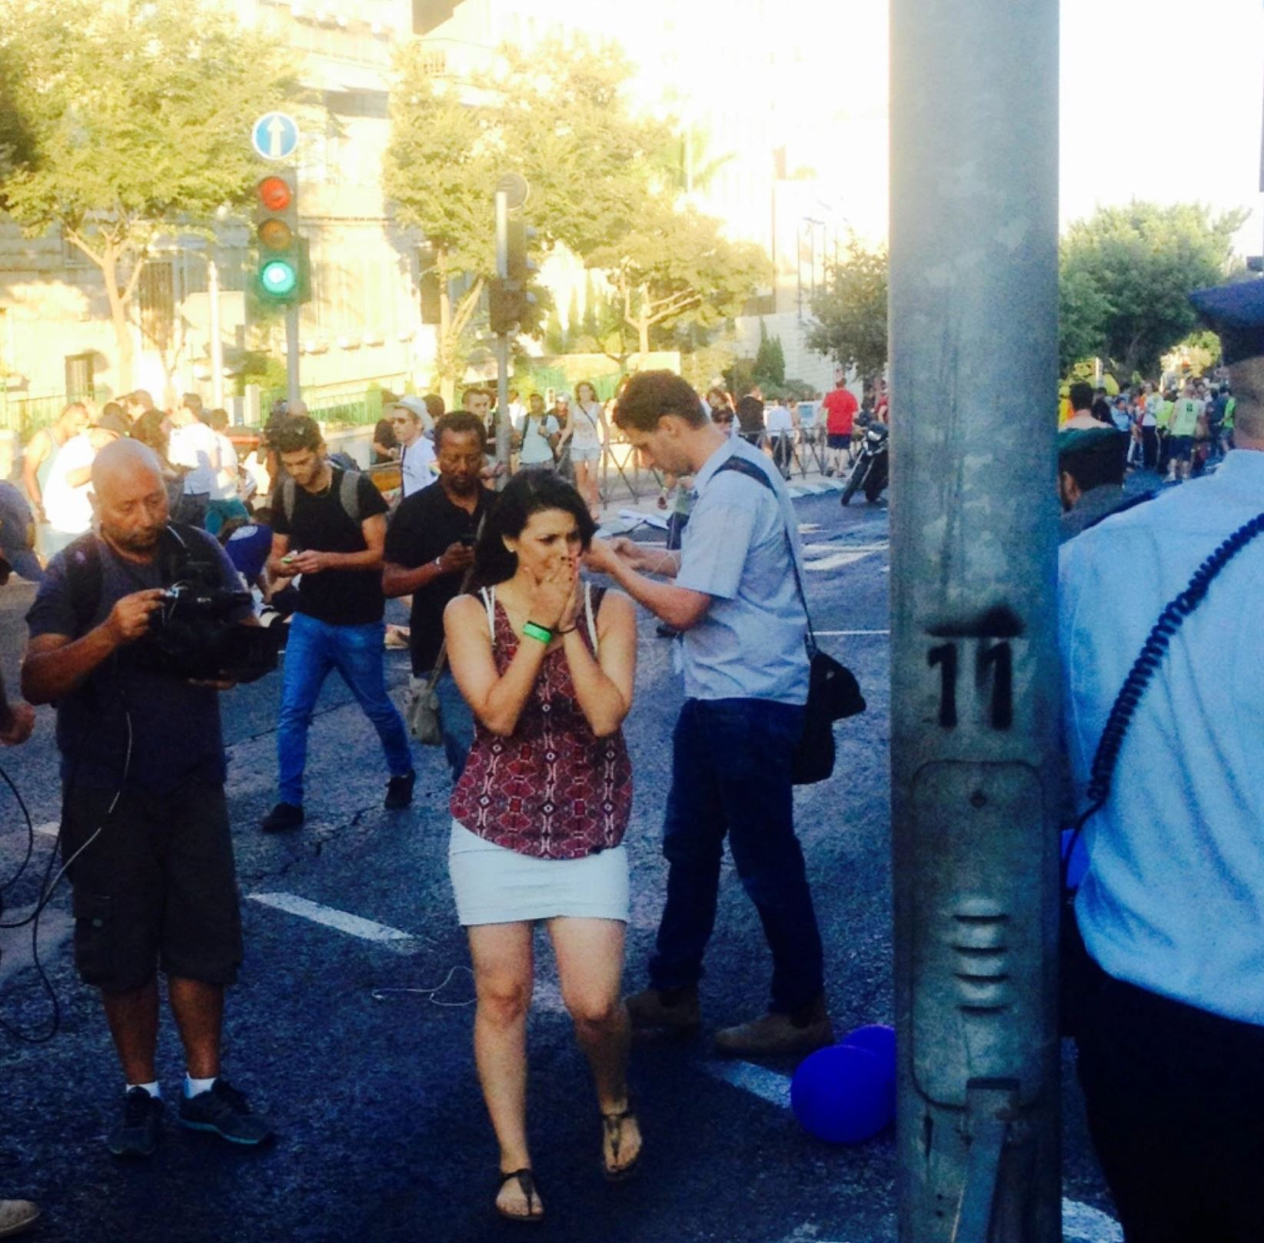
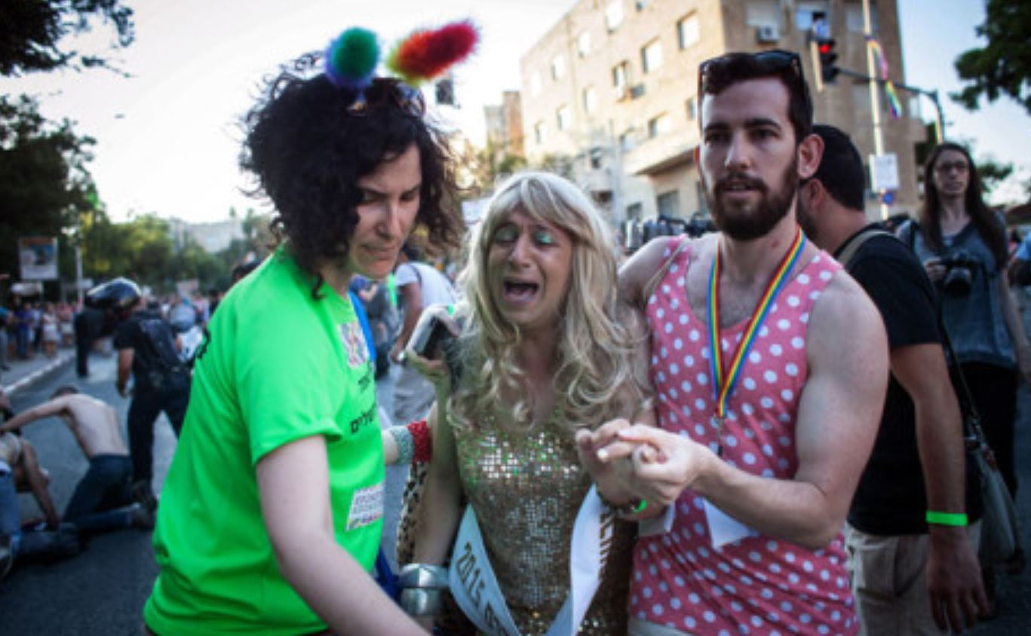
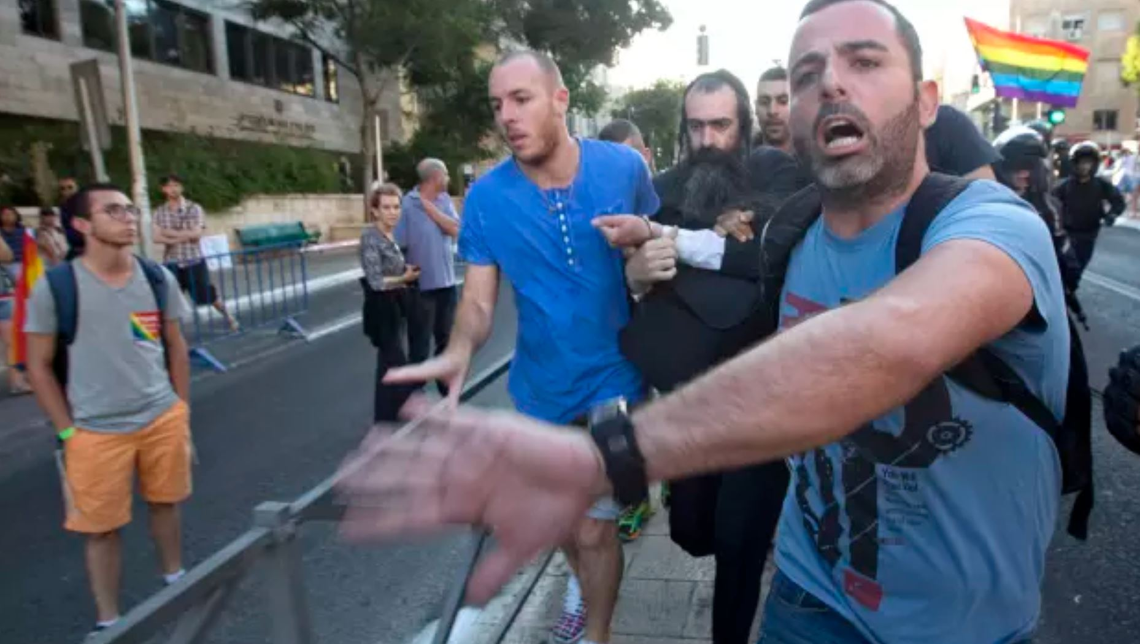

2015 Jerusalem pride

Slide 5
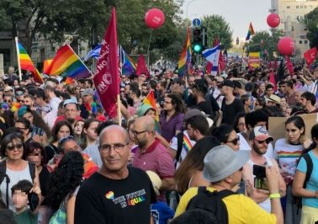
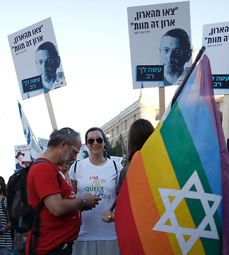
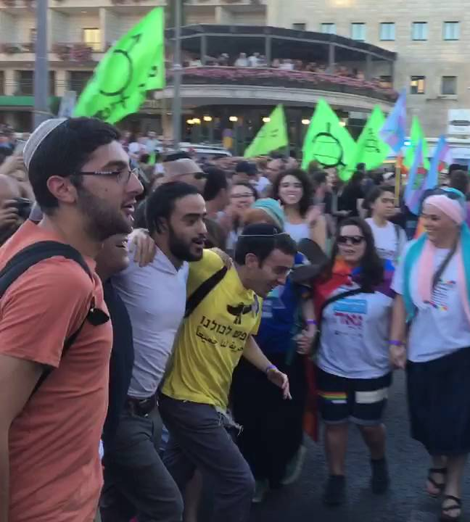
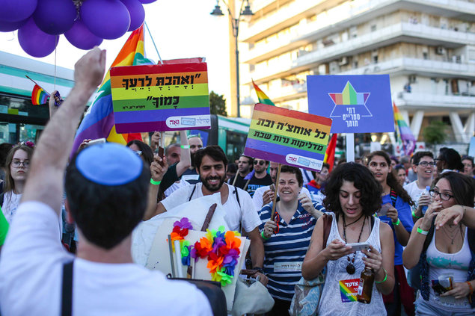
2016 Jerusalem pride

Slide 6
How does a society change?

Slide 7
THREE change-makers
Salon
Streets
Suits

Slide 8








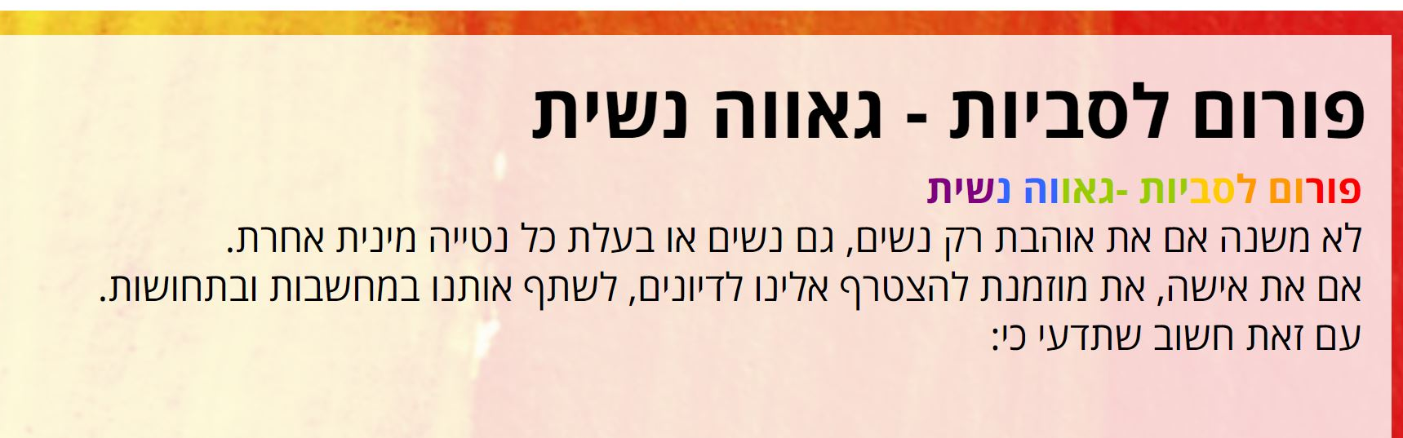
Salon

Slide 9
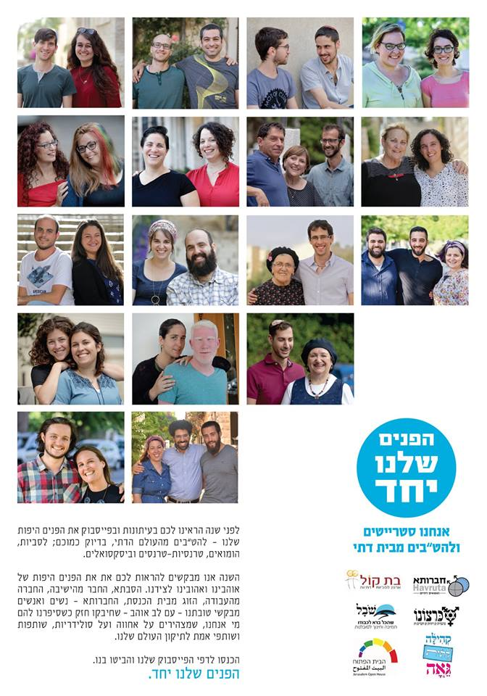
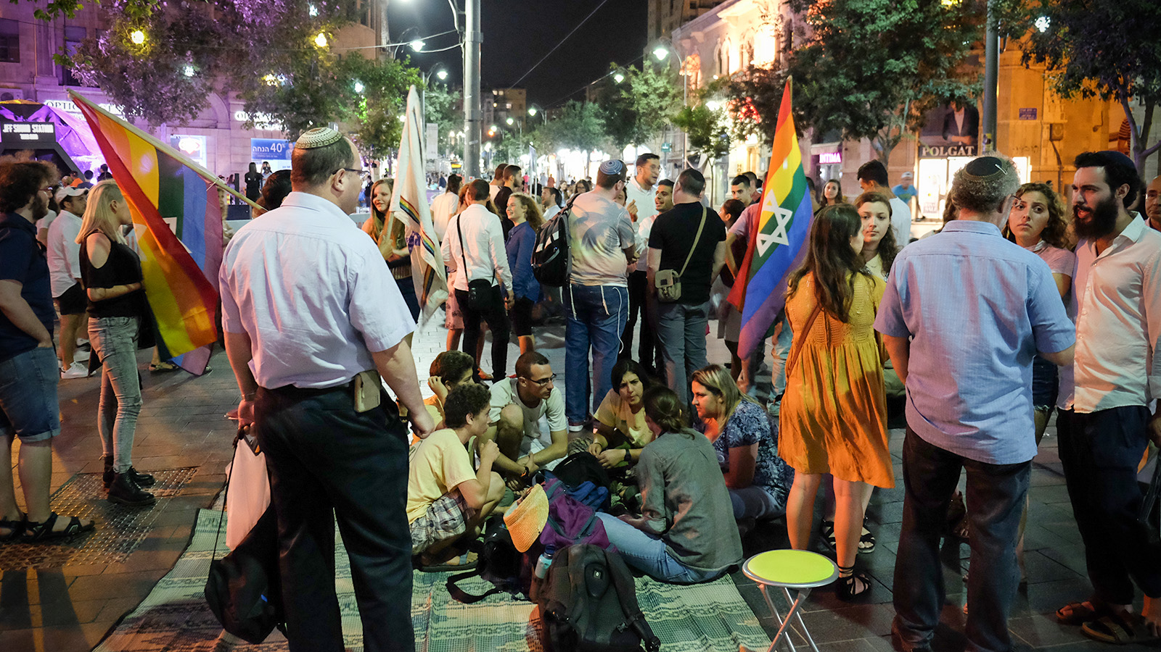
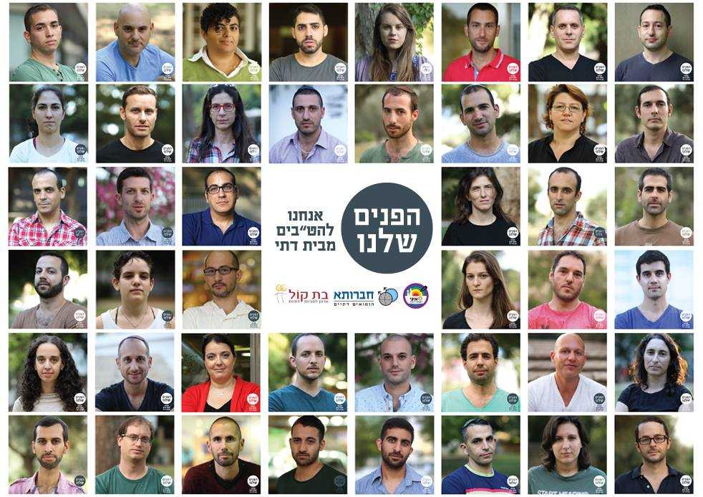
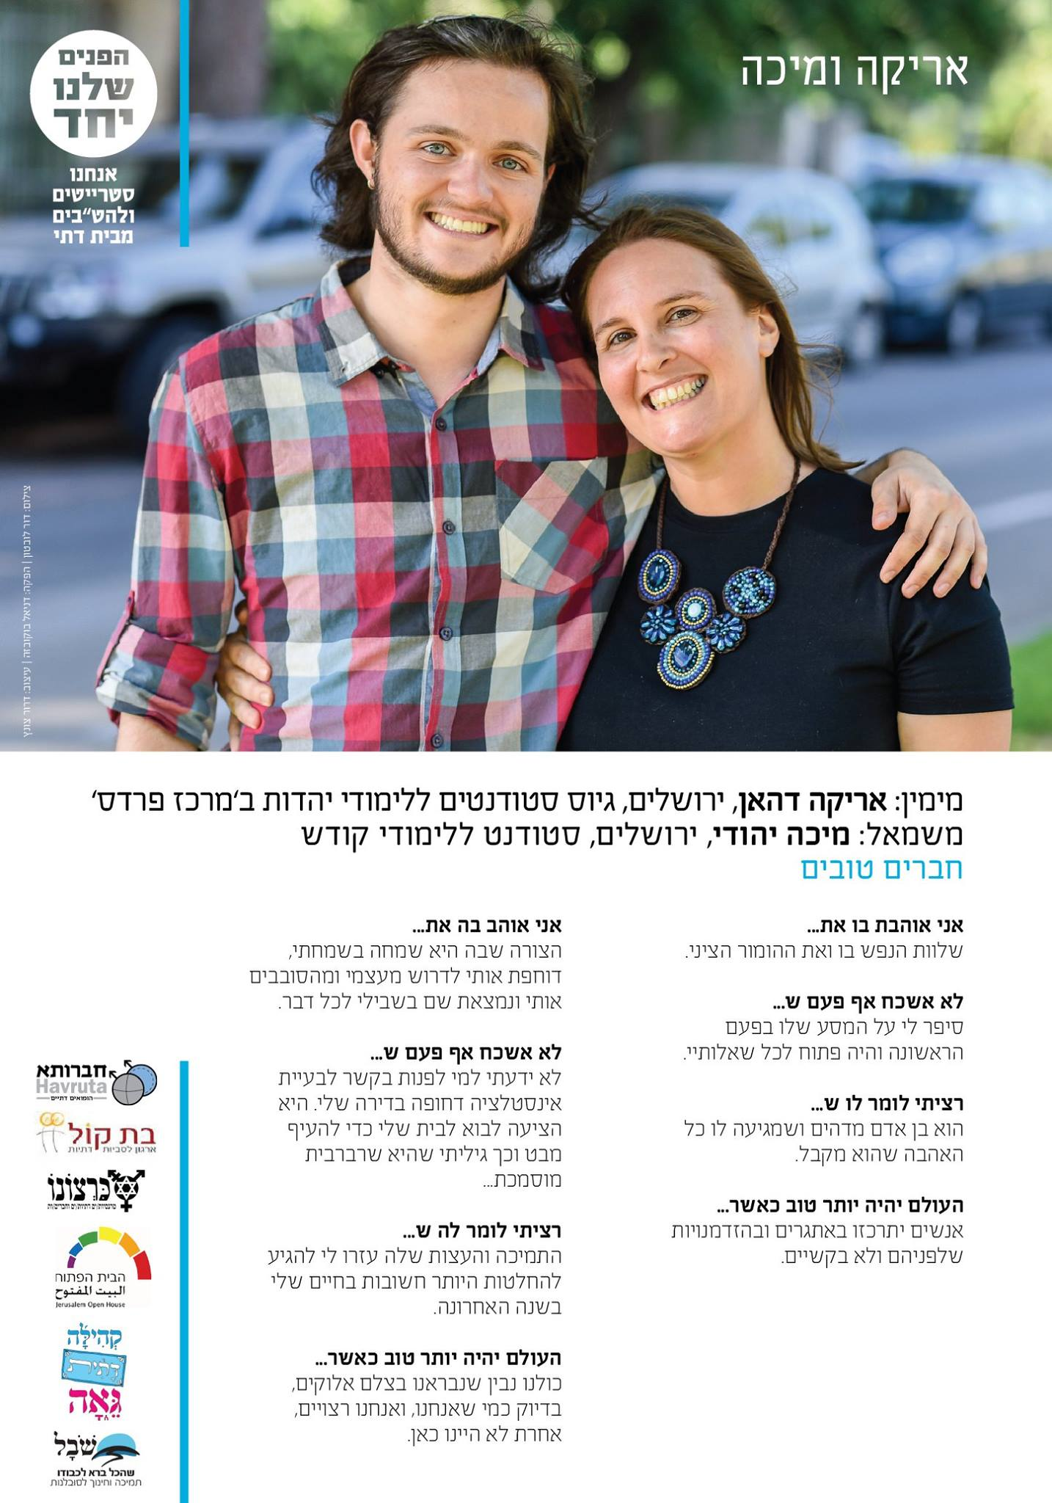
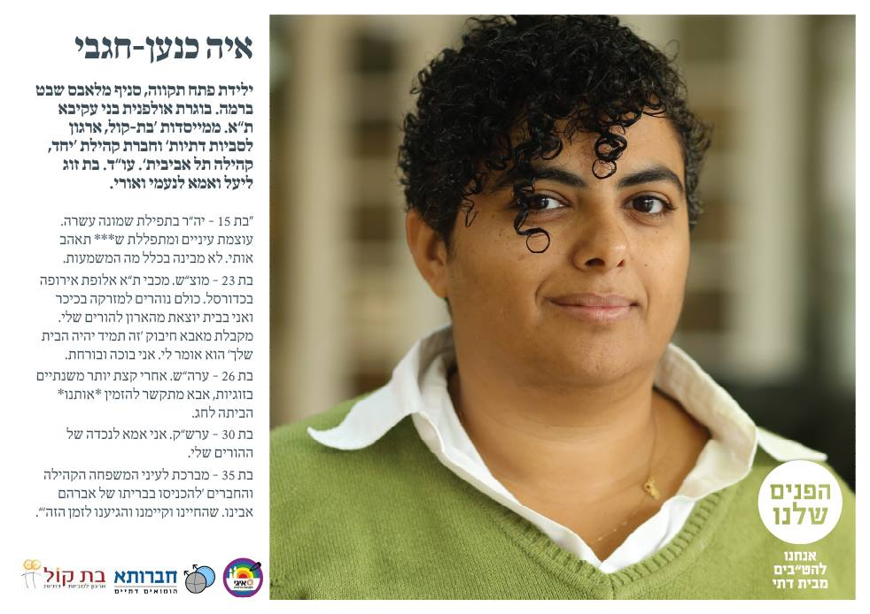
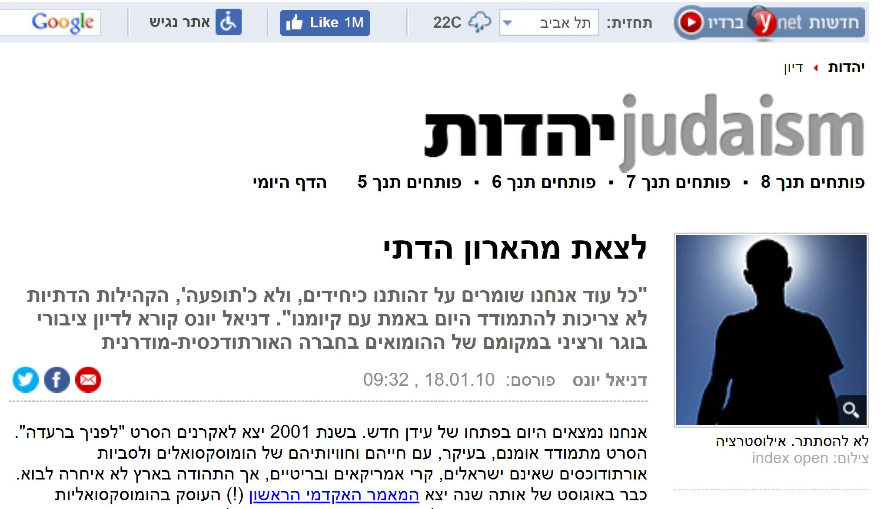
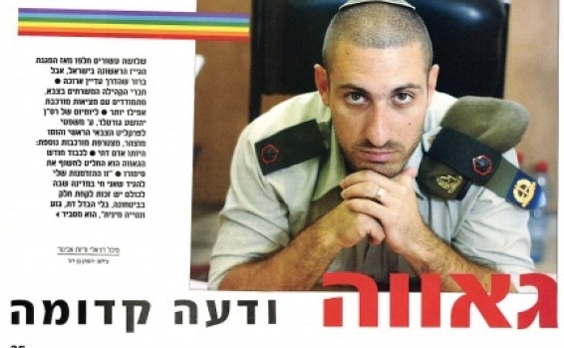
STREETs
Notes:
Grosman video - https://www.youtube.com/watch?v=y52eBwA3gOw

Slide 10


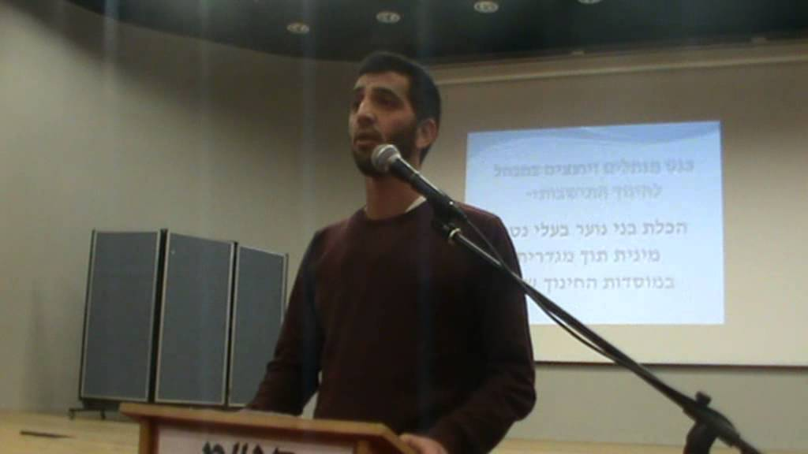
Suits

Slide 11
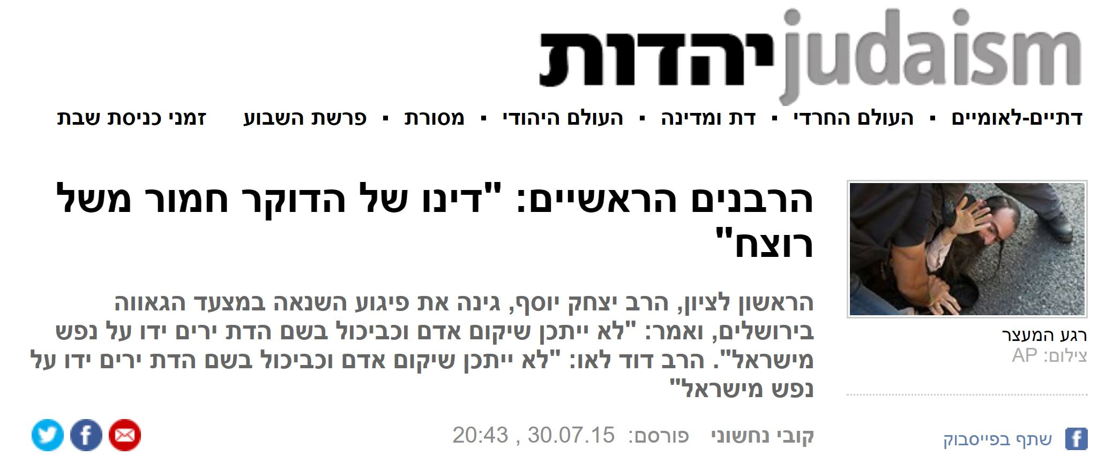

Jerusalem pride 2015
Notes:
Rabbis apologize - https://www.youtube.com/watch?v=doCKrmpy1zI
Dancing at Pride - https://www.youtube.com/watch?v=Phx_6GNAfQY

Slide 12


Slide 13



How does a society change?

